Slide 1

GIMP Tutorial
v2018-11
Boo Virk, Simon Andrews, Jo Montgomery
Babraham.bioinformatics@babraham.ac.uk

Slide 2
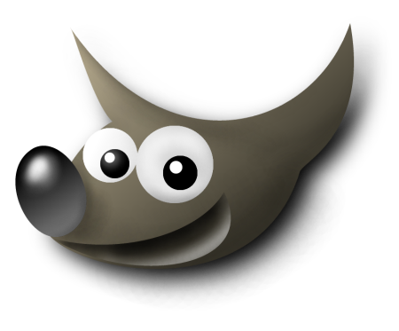
What is GIMP
GNU Image Manipulation Program
Bitmap Graphics Editor
Open Source
Cross Platform
Not for Vector editing
www.gimp.org

Slide 3
Vector vs Bitmap

Slide 4
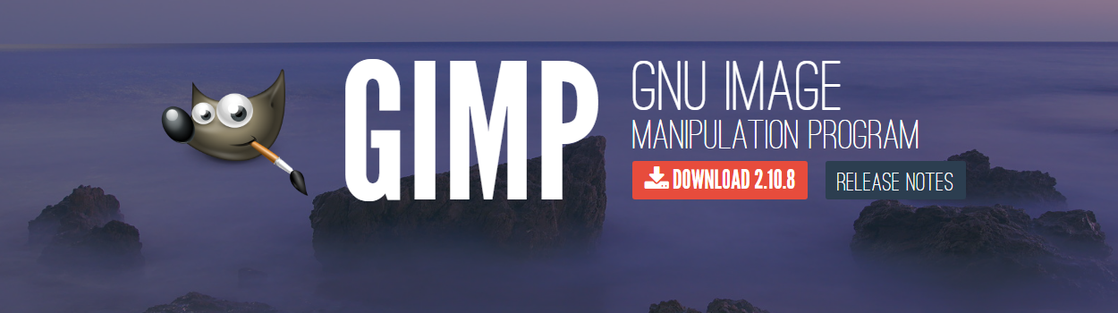
Getting GIMP
www.gimp.org
Open Source
Cross Platform

Slide 5
Basic Layout
View Toolbox – Windows > New toolbox or (Ctrl + B)
View Layers Dialogue box – Windows > Dockable Dialogs > Layers or (Ctrl + L)
GIMP can do a lot of things – will show you small selection of tools that are ethically acceptable to use for figure production

Slide 6
Opening Images
To open an image for editing:
Drag file onto a new GIMP window
or
File > Open or (Ctrl + O)
After opening, save a working copy of the file
GIMP saves files as XCF files by default, but you can export files in other formats (e.g. PNG)

Slide 7
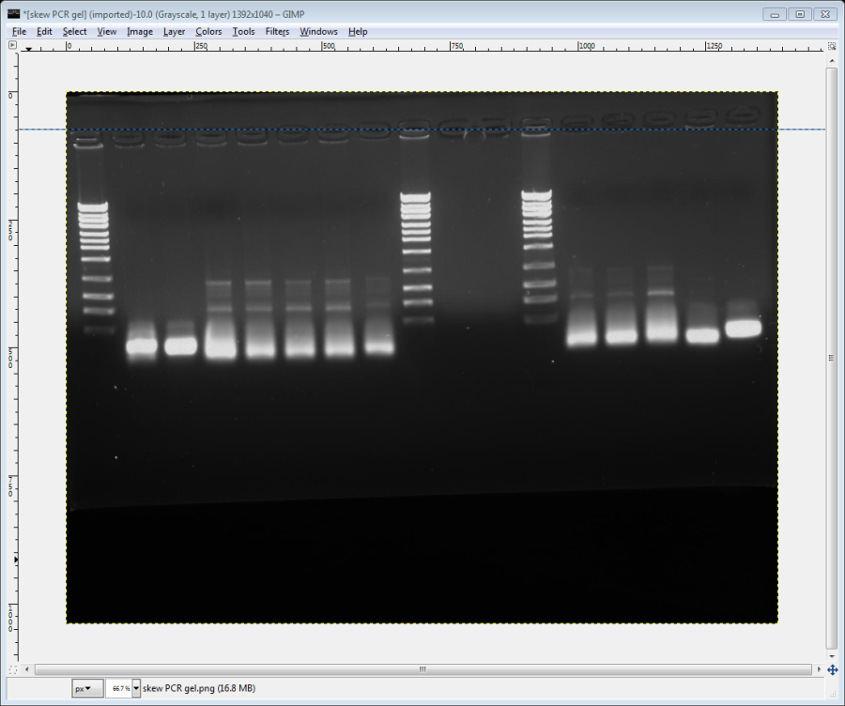
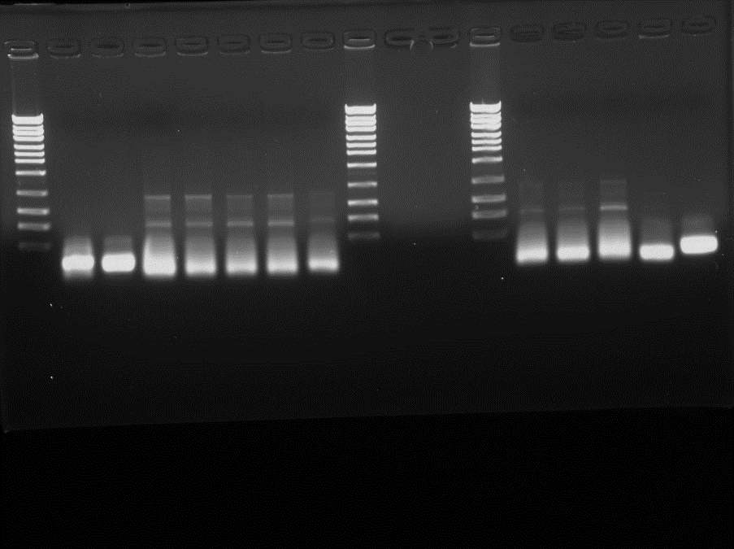
Straightening Images
Drag a horizontal guide line onto your image (from top ruler) to intersect an area that should be perfectly horizontal
Using the ‘Rotate’ tool (Shift + R) rotate the image so that it lines up with the guideline
When you start to rotate the image, a dialogue box will appear

Slide 8
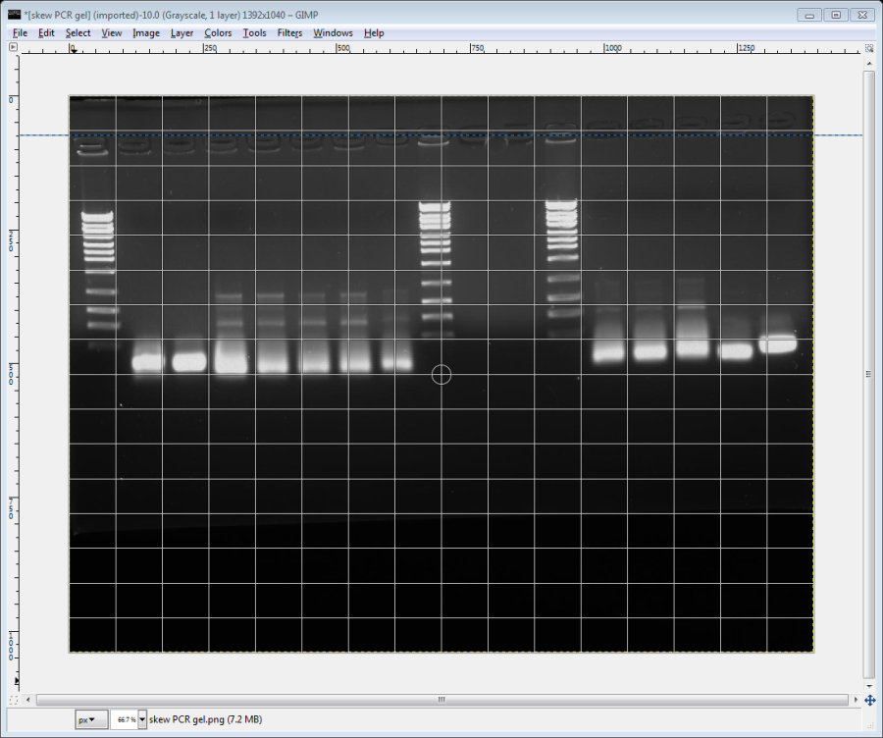
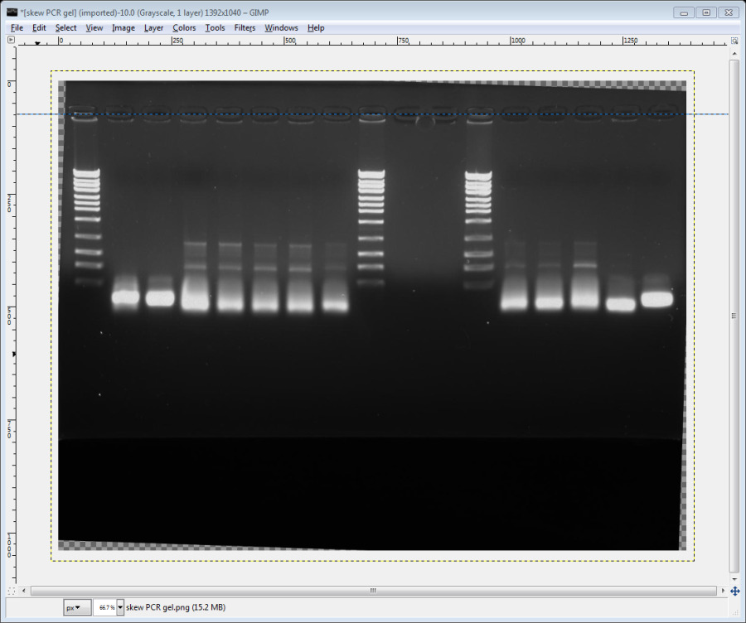
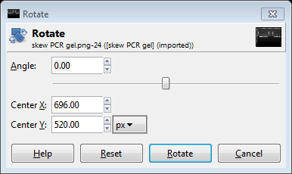
Straightening Images
When finished click the rotate button to apply
To remove guideline: Image > Guides > Remove all Guides

Slide 9
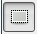
Cropping Images
Useful to crop unnecessary edges away
Can reduce file size when bringing images into a vector file
Use the ‘Rectangle Select’ tool (R) to draw a box around the area of the image you want to keep

Slide 10
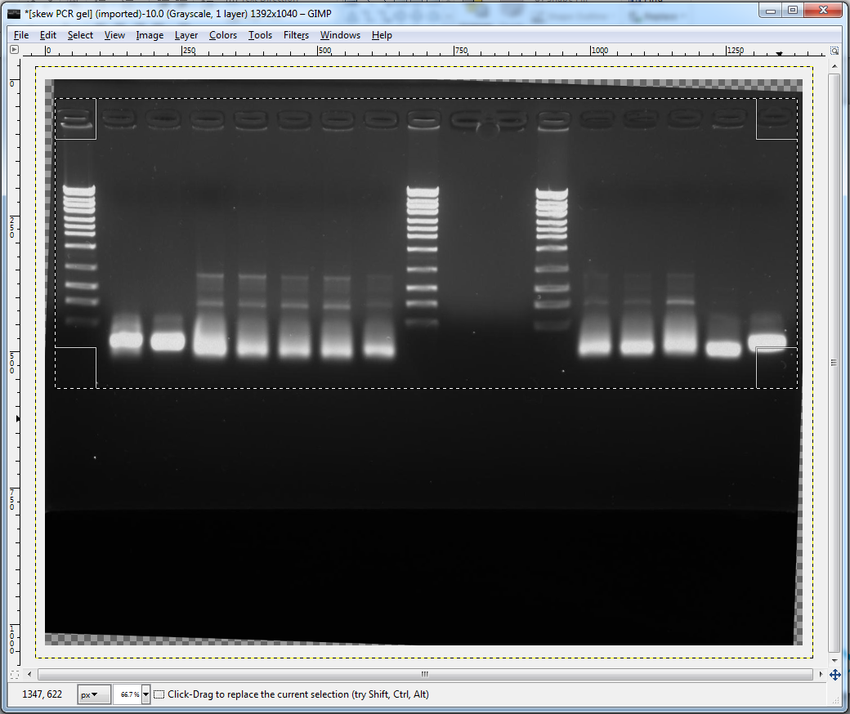
Cropping Images
Click and drag the corners of the box after drawing to fine tune
Crop: Image > Crop to Selection
Don’t forget about Ethics!

Slide 11
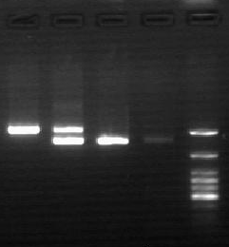
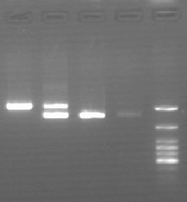
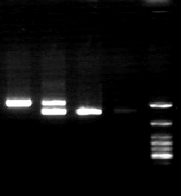
Brightness and Contrast
Increasing Brightness
Increasing Contrast

Slide 12
Brightness and Contrast
Adjusting brightness and contrast can help the clarity of your image
In GIMP,
Colours > Brightness-Contrast
If a selection box is marked, brightness and contrast will be adjusted in selected area only

Slide 13
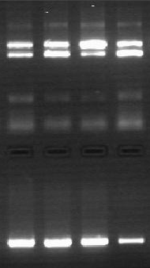
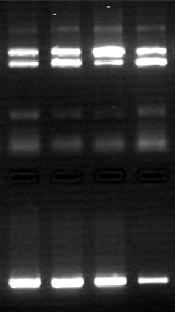
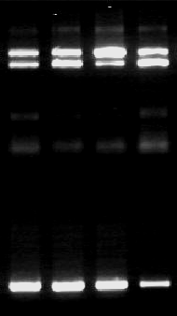
Brightness and Contrast
Original
Brightness and Contrast adjusted
Brightness and Contrast adjusted too much
image is oversaturated
Unethical

Slide 14
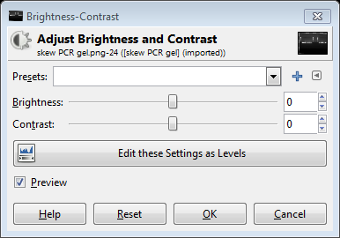
Colour Levels
Brightness and contrast should be edited by adjusting colour levels
Colors > Levels
Or:
Dialogue box shows histogram of colour value usage
Useful to display a Logarithmic histogram so that values aren’t hidden at the bottom of the graph

Slide 15
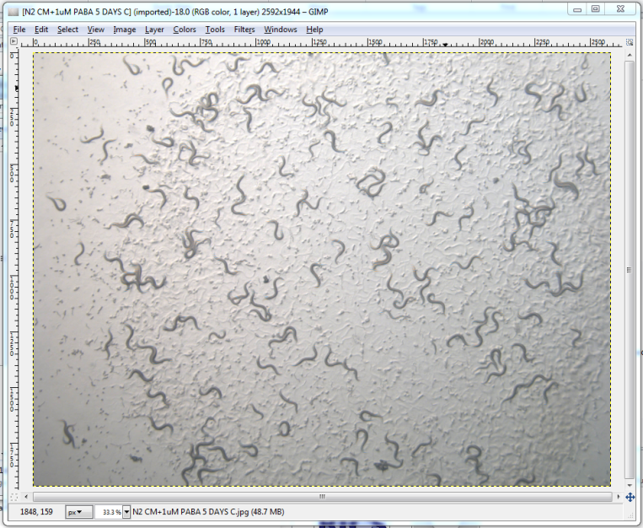
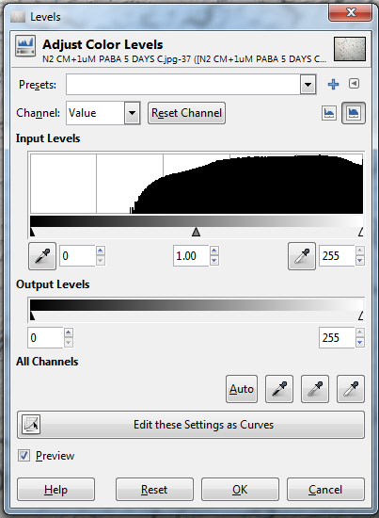
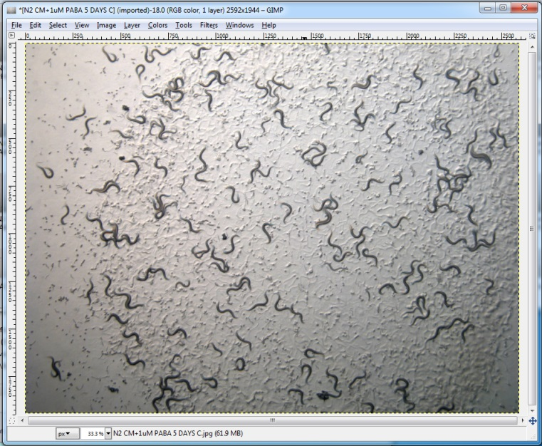
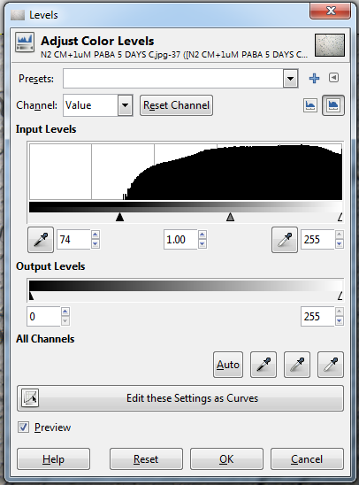
Colour Levels
Display Logarithmic Histogram
The middle handle will adjust the midpoint of the levels and represents non-linear editing of colours.
This is not ethically acceptable for publication!

Slide 16
Alpha channel
Alpha channels are masks through which you can display images
Within an alpha channel:
White acts as the visible area
Black acts as the transparent area
Level of gray in between determines the level of visibility.

Slide 17



Why use an alpha channel?

Slide 18
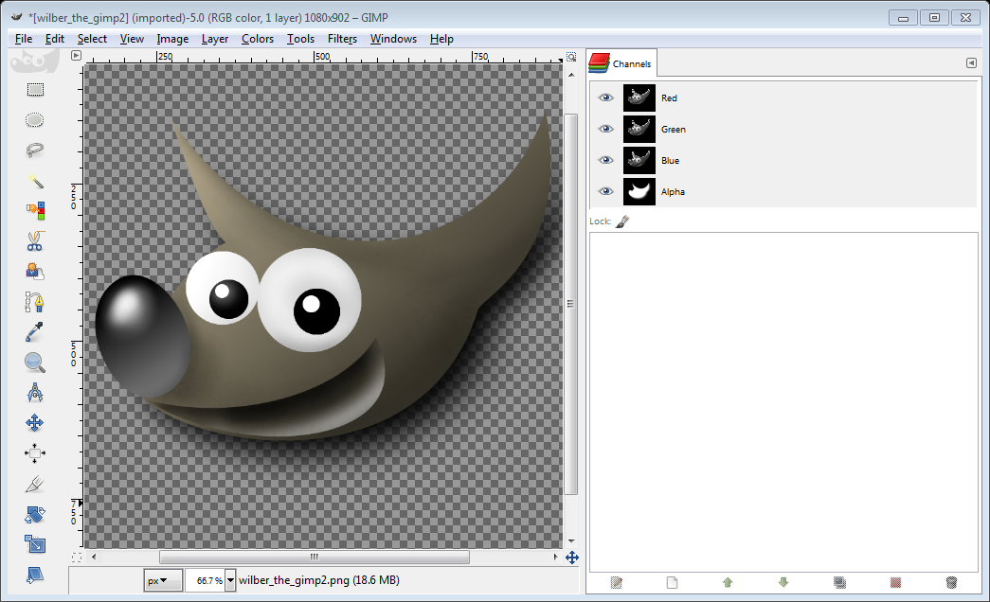
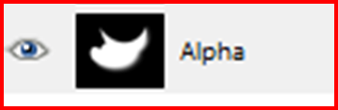
In GIMP
Layer > Transparency > Add Alpha Channel

Slide 19
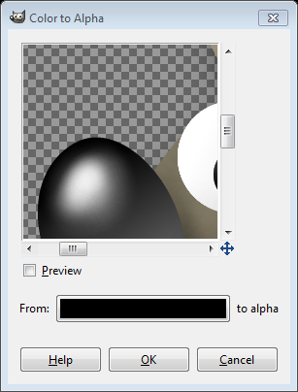
Colour to Alpha Channel
You can assign a colour to the alpha channel, which will make all pixels in your image with the assigned colour transparent
In GIMP
Colors > Color to Alpha
Preview, indicating which areas are to be transparent
Use this tool to pan around the preview
Colour swatch – for selecting colour to become transparent

Slide 20
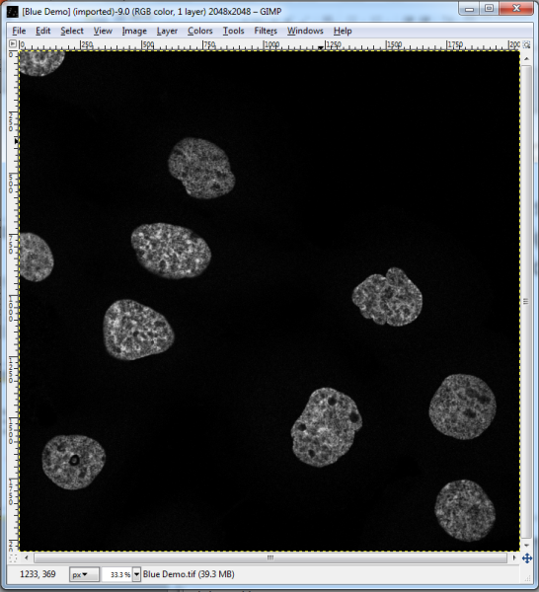
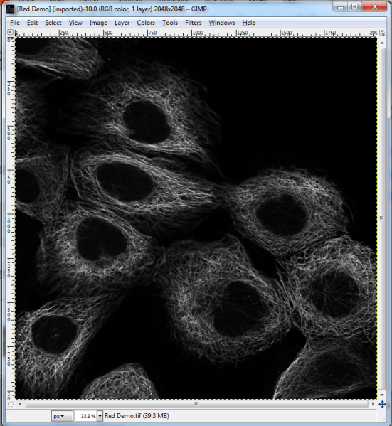
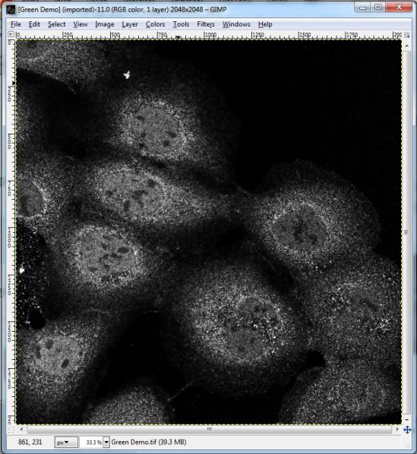
Pseudo-colour Overlays
Some experiments such as FISH microscopy may generate multiple greyscale images which can be overlaid to form a pseudo-colour image

Slide 21
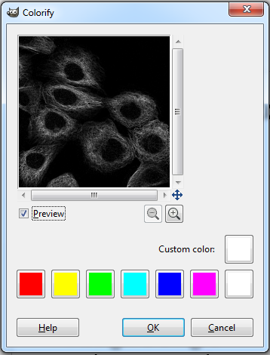
Pseudo-colour Overlays
Ensure image is in RGB mode
Image > Mode > RGB
Assign a single colour to each image (v2.8)
Color > Colorify
Notes:
Version 2.8 still works like this. They have removed this function from newer versions. For version 2.10, see next slide.

Slide 22
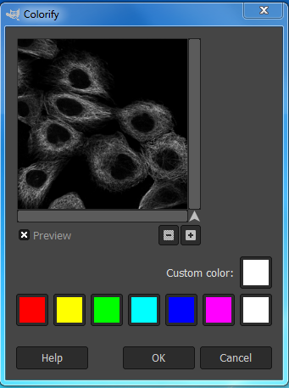
Pseudo-colour Overlays
Ensure image is in RGB mode
Image > Mode > RGB
Assign a single colour to each image (v2.10)
Help > Search and Run a command
“Colorify”
Colorify
Replace all colors with shades of a specified color
Notes:
V 2.10 you can either add a plug-in (code) or just follow these simple steps

Slide 23
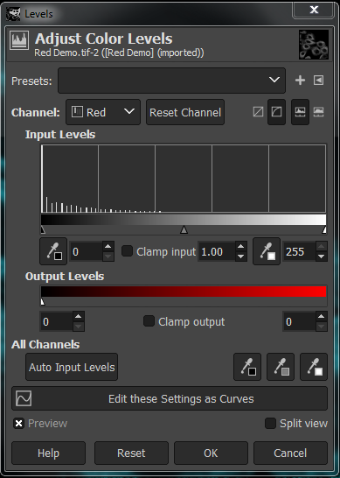
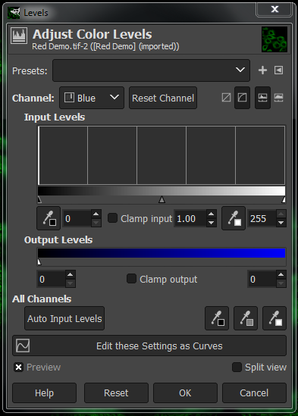
Or … Colors > Levels
Dial down the colours you don’t want

Slide 24
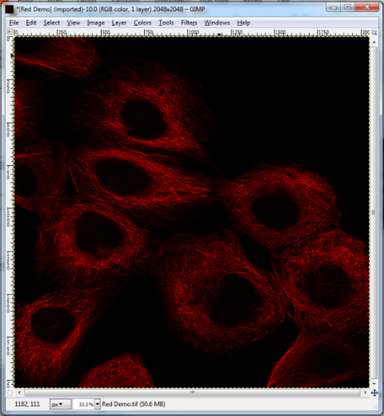
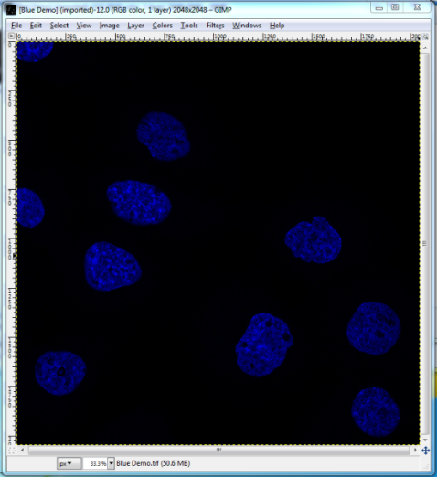
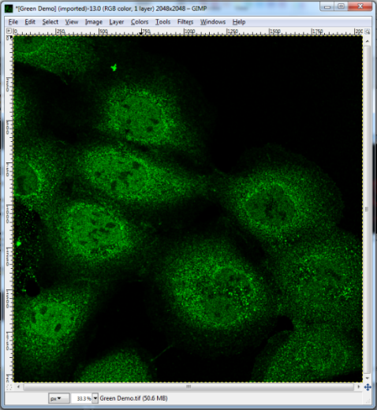
Pseudo-colour Overlays
Once images are correct colours, we need to overlay them
Open Layers dialogue box (if not already open)
Windows > Dockable Dialogues > Layers
(Ctrl+L)

Slide 25
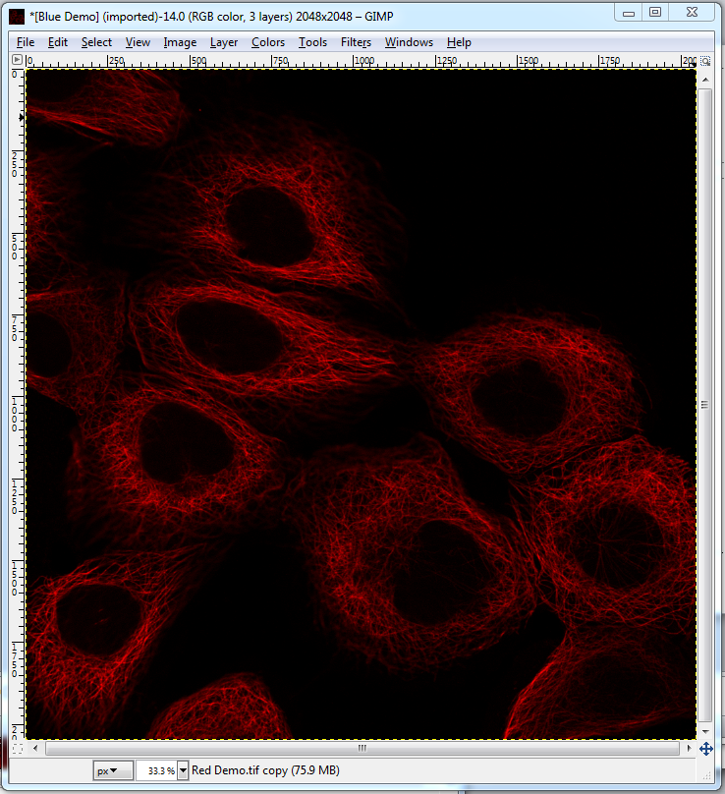
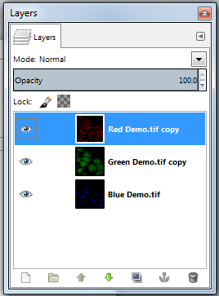
Click and drag image layer in to the working window of another image
Repeat this until one image has all of the desired layers

Slide 26
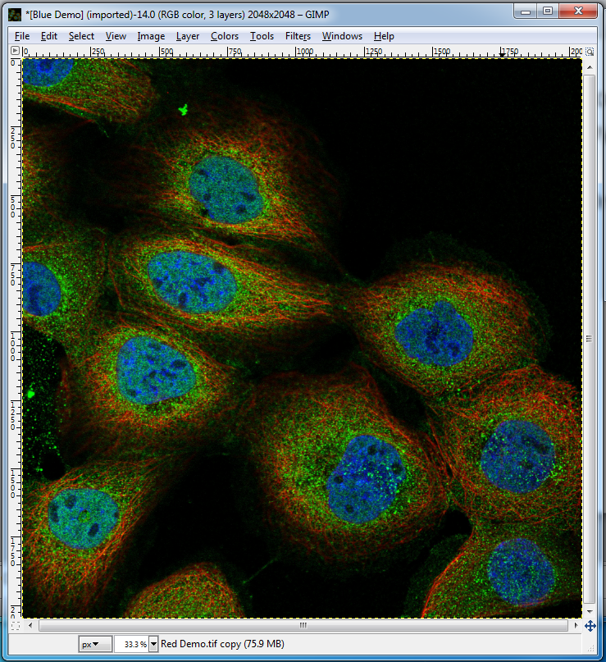
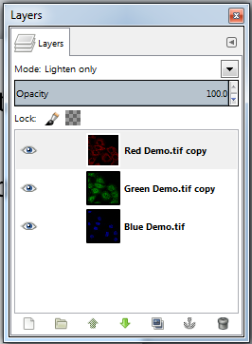
Finally, make each layer (except the bottom layer) show only its colour, making the underlying layers visible
Layer Dialogue Box -> Mode > ‘Lighten Only’

Slide 27
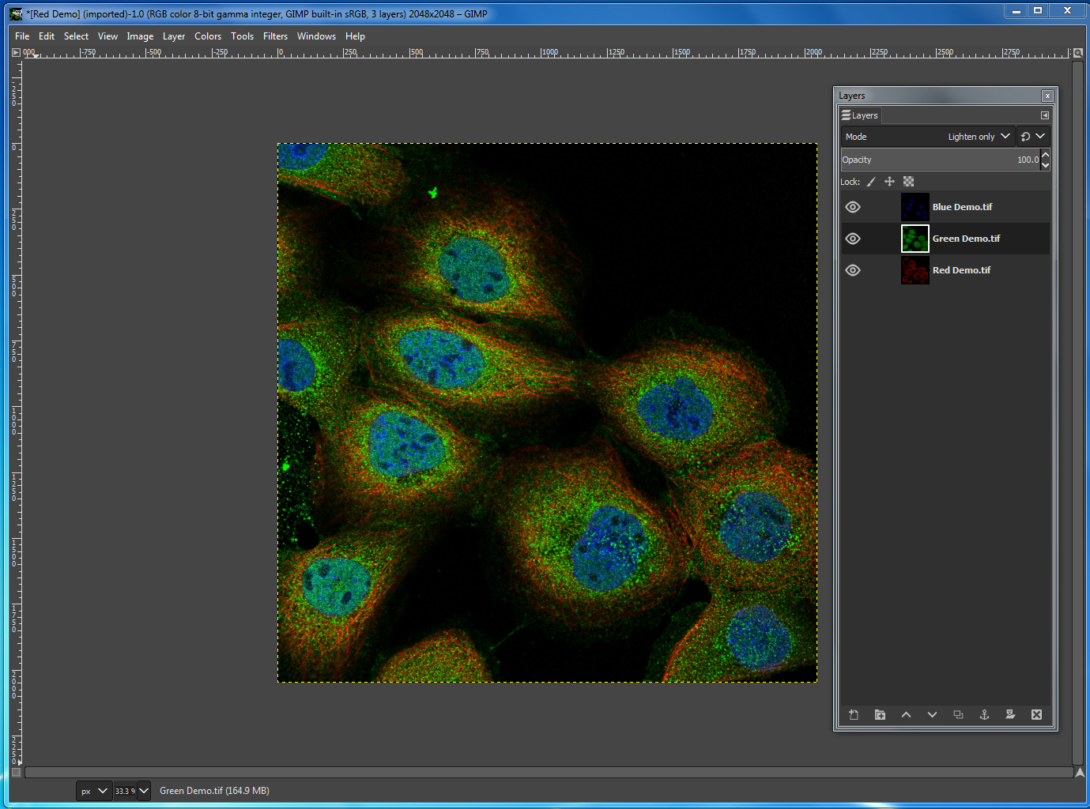

Slide 28
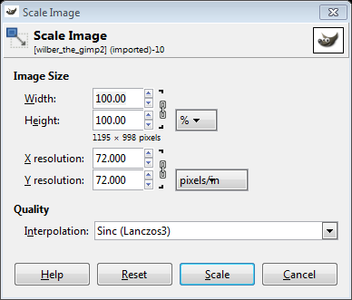
Scaling Images
GIMP can be used to scale the size of your image
Image > Scale Image
Avoid making your images bigger than original size, bitmaps do not scale up well!

Slide 29
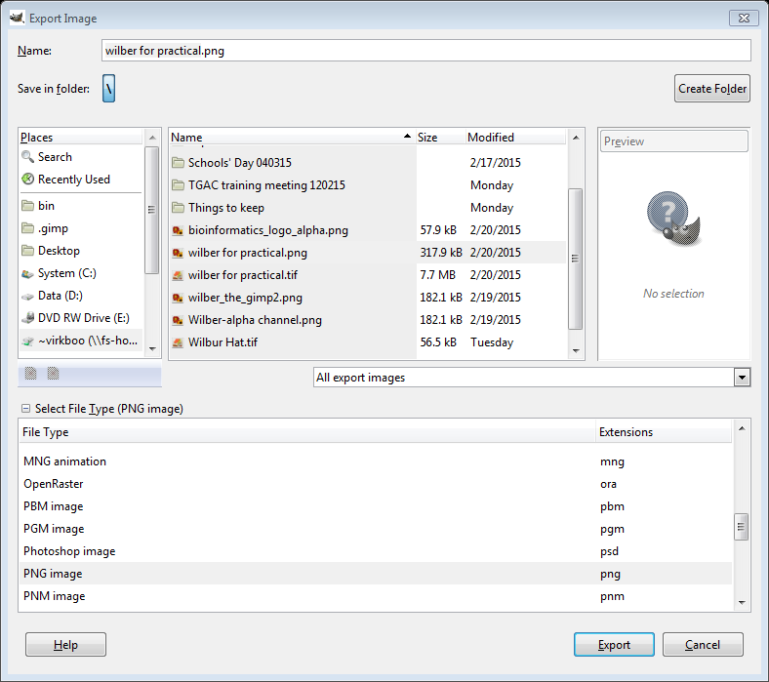
Exporting Images
Once editing is done, and the working XCF file is saved, you need to export the image
File > Export As…
Specify file format e.g. PNG
Always save your image as a PNG file, maintains transparency (alpha channel) and is lossless

